Slide 1

Sentinel AI
Live Chat Sentiment Analysis Dashboard

Slide 2
The Problem: Data Overload
We have thousands of customer conversations. How do we find the critical moments of frustration or success *in real-time*?

Slide 3





The Solution: An Integrated AI Dashboard
Live Analysis
Train & Adapt
Batch Insights
Analyze sentiment for every message as it happens, providing instant feedback to agents and managers.
Dynamically re-train the AI model on new data directly within the app to improve its accuracy over time.
Upload historical conversation logs (CSVs) to analyze past performance and identify large-scale trends.

Slide 4

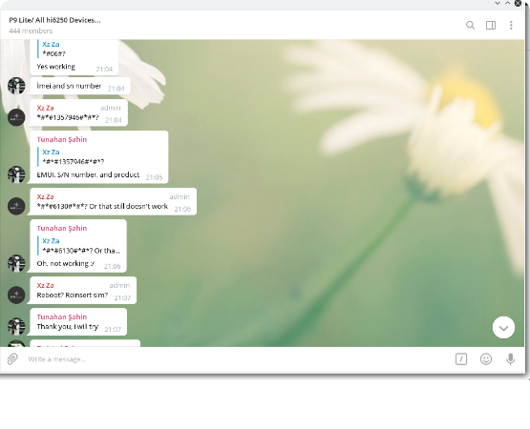
Feature: The Live Chat Interface
Real-Time Scoring
The core of the app is the live chat log. It provides immediate, color-coded sentiment feedback for every message from both the customer and the agent.
•
Customer messages align left.
•
Agent messages align right (on supported versions).
•
Sentiment is instantly scored and displayed.

Slide 5


Feature: Instant Sentiment Feedback
Negative Sentiment (▼ -1.0)
Positive Sentiment (▲ +1.0)
A red, downward-pointing arrow provides a clear visual warning. This instantly flags customer frustration, allowing a manager to intervene or an agent to adjust their strategy.
A green, upward-pointing arrow highlights success. This helps confirm a resolution, reinforces positive agent behavior, and identifies satisfied customers.

Slide 6
Feature: The Sentiment Dashboard (Metrics)
At-a-Glance KPIs
-0.31
The dashboard provides a high-level summary of the entire conversation's health. By tracking the average sentiment for all parties, managers can quickly assess the call's tone.
Overall Conversation Sentiment
These metrics update live with every new message, providing a real-time pulse on the conversation.

Slide 7
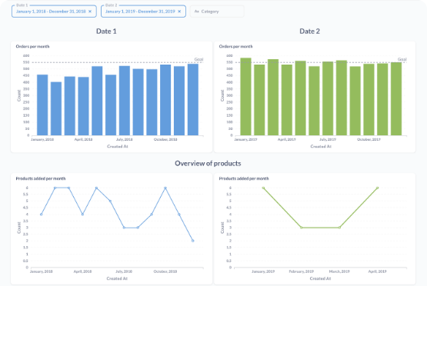
Feature: The Sentiment Dashboard (Trends)
Visualizing the Conversation Flow
We provide two critical trend charts:
1.
Per-Message Trend: Spots the *exact moment* a conversation turns positive or negative.
2.
Cumulative Trend: Shows the *overall direction* of the chat. Is it recovering or getting worse?

Slide 8

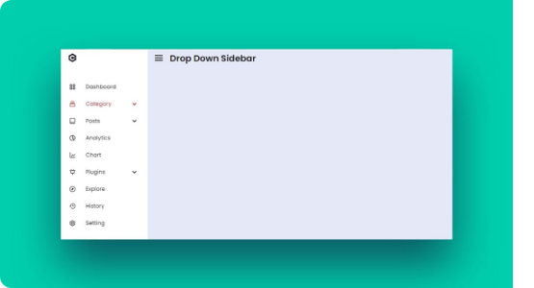
Demo Feature: Conversation Simulations
Test the Model in Real-Time
To demonstrate the model's accuracy, you can select from several pre-built conversation simulations from different agents (Alice, Bob, Carol).
This allows you to showcase how the model handles a positive resolution, a negative escalation, or a neutral procedural chat, step-by-step.

Slide 9
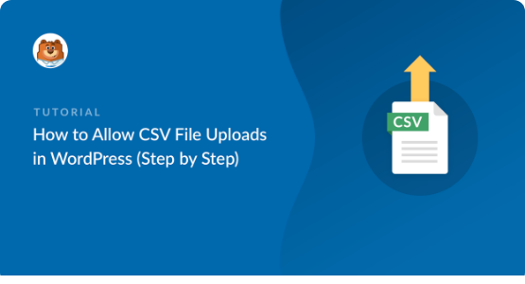
Power Feature: Batch Analysis
Analyze Historical Data
Move beyond live analysis. The app allows you to upload an entire CSV of past conversation logs.
This feature is perfect for quarterly reviews, analyzing agent team performance, or identifying widespread customer issues from a specific time period.

Slide 10

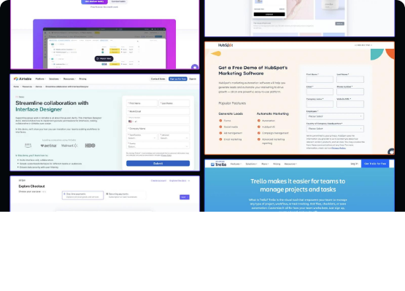
Power Feature: On-Demand Model Training
A "No-Code" ML Hub
This is the most powerful feature. You don't need a separate data science team to update the model.
Directly in the app, you can:
•
Select the compute device (GPU/CPU).
•
Dynamically define the neural network architecture.
•
Train the model on new data and get real-time ETR.

Slide 11
Summary: A Complete Sentiment AI Tool
Analyze: A live dashboard for real-time, message-by-message sentiment scoring.
Simulate: Demonstrate model behavior with pre-built positive, negative, and neutral conversation scenarios.
Investigate: Batch upload historical data (CSV) to find large-scale trends and review past performance.
Adapt: Re-train and configure the AI model on the fly, directly in the app, to ensure it constantly improves.

Slide 12
Questions?

Slide 13









Image Sources
https://user-images.githubusercontent.com/34889164/46974588-be51cf00-d0c4-11e8-9215-dd0b64b175e9.png
Source: github.com
https://www.metabase.com/learn/images/compare-times/side-by-side-dashboard.png
Source: www.metabase.com
https://www.sliderrevolution.com/wp-content/uploads/2024/09/css-sidebar-menus-f.jpg
Source: www.sliderrevolution.com
https://wpforms.com/wp-content/uploads/2020/07/how-to-allow-csv-file-uploads-in-wordpress-step-by-step_b.png
Source: wpforms.com
https://cdn.sanity.io/images/q9c9g16o/production/bcb7b2200262813f5f0035984127219f28c04143-1600x840.webp
Source: www.webstacks.com

